Slide 1

Choosing the Right Approach
A guide to an Agile Transition
Danny Forte
December 15, 2024

Slide 2
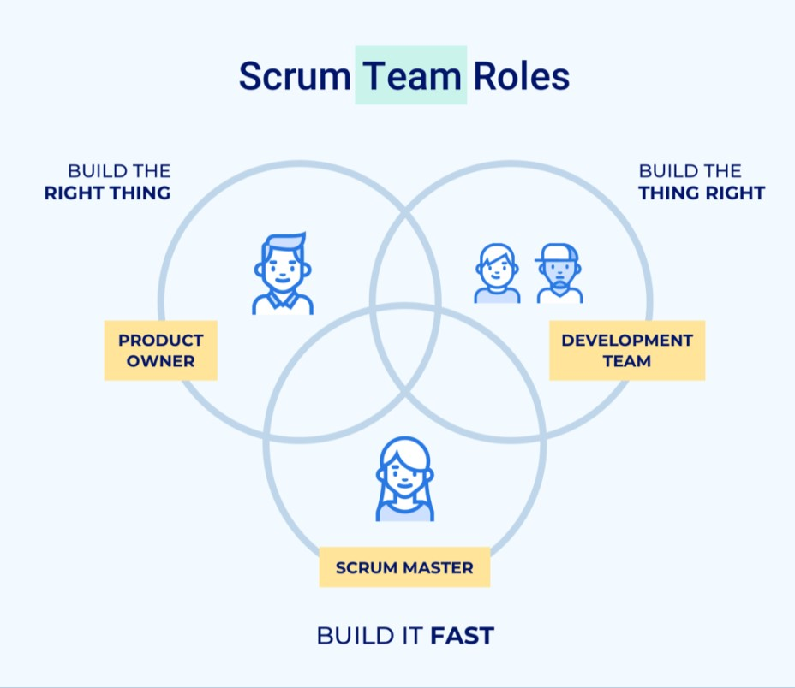
The Key Roles in a Scrum-Agile Team
Product Owner: Prioritizes and Defines the product backlog, ensuring the team delivers value to the client
Scrum Master: Facilitates scrum events, removes roadblocks and makes sure team adheres to Agile principles
Development Team: Turns user stories into working software increments, working as a team focused on one goal
https://inspiringsandhya.com/scrum-for-beginners-a-step-by-step-guide/

Slide 3
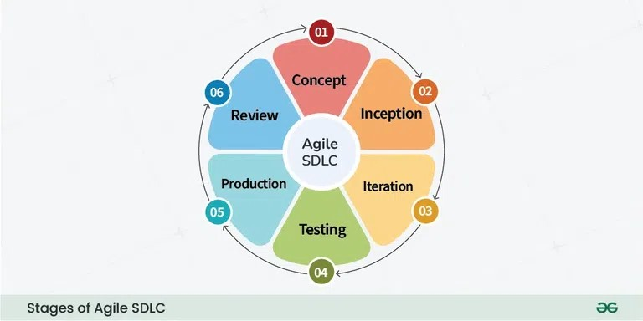
Stages of the SDLC in Agile
Concept: Project goals, costs and features are defined. Consider feasibility with stakeholders
Inception: Team is created, roles are assigned tools and architecture are defined
Iteration: Product is developed during sprints, incorporating feedback and documenting as needed
Testing: Ensuring the quality and functionality of work and verify it meets the clients requirements
Production: Completed work is released to conduct final testing and for feedback
Review: Collecting user feedback and implementing updates and provide ongoing support.
https://media.geeksforgeeks.org/wp-content/uploads/20240118170922/Stages-of-Agile-SDLC-768.webp

Slide 4
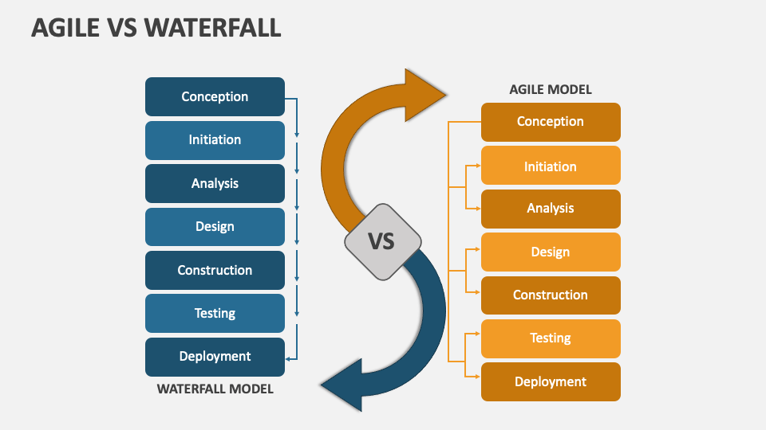
Comparing Waterfall vs. Agile
Waterfall Model:
Sequential Phases: Requirements, Design, Implementation, Testing, Deployment and Maintenance
Fixed Scope of Work: Changes are costly and cause delays once the process starts
Example: A critical bug is found during testing would mean significant reworking or even scraping the entire project and starting over depending on where the bug is found.
Agile Model:
Iterative and Incremental: Allows for adjustments based on feedback and testing
Flexibility: Able to incorporate changes and improvements easily during development
Agile vs Waterfall PowerPoint and Google Slides Template - PPT Slides

Slide 5
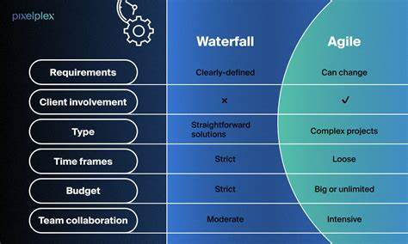
How do you decide which is best?
Product Requirements: Well-defined (Waterfall) vs. undefined and evolving (Agile)
Stakeholder Involvement: :Limited to none (Waterfall) vs. High engagement with feedback (Agile)
Flexibility: Strict order of steps and sequence(Waterfall) vs. Adaptive and changeable (Agile)
Project Complexity and size: Large well defined projects (Waterfall) vs. complex and responsive (Agile)
Agile vs Waterfall: Which Development Approach is Better?

Slide 6
References
Agile vs Waterfall: Which Development Approach is Better? (n.d.). PixelPlex. https://pixelplex.io/blog/agile-waterfall-software-development/‌
kumar, K. (2022, September 18). Agile SDLC | Introduction to Agile Software Development Lifecycle. Cloud Training Program. https://k21academy.com/scrum-master/agile-sdlc/
Scrum for Beginners: A Step-by-Step Guide. (2023, May 24). SANDHYA BLOG. https://inspiringsandhya.com/scrum-for-beginners-a-step-by-step-guide/
Sketchbubble. (2024). Agile vs Waterfall PowerPoint and Google Slides Template. Sketchbubble.com. https://www.sketchbubble.com/en/presentation-agile-vs-waterfall.html‌
‌ Stages of the Agile SDLC (Software Development Lifecycle). (2024, January 18). GeeksforGeeks. https://www.geeksforgeeks.org/stages-of-the-agile-sdlc-software-development-lifecycle/

